Slide 1




Platinum Health Client Liaison Officer at your Service
Ntsako Ngoveni
Client Liaison Officer
Our Client Liaison Officer Ntsako Ngoveni is available on-site and ready to assist you with any Scheme related queries.
Contact Details
Office: 087 463 0812
Mobile: 060 571 0870
E-mail: Ntsako.Ngoveni@platinumhealth.co.za
Services Offered:
  Membership application
  Member queries and complaints.
  Authorisations and Specialist referrals.
  Access to our WhatsApp Services
  How to apply for and access your Chronic Medicine.
  How to find the Platinum Health Designated Service Providers.
  Claims and refunds.
  Tax certificates
  Scheme procedures.
  Continuation of membership
  Scheme benefits; and
  Any service enquiries
1

Slide 2


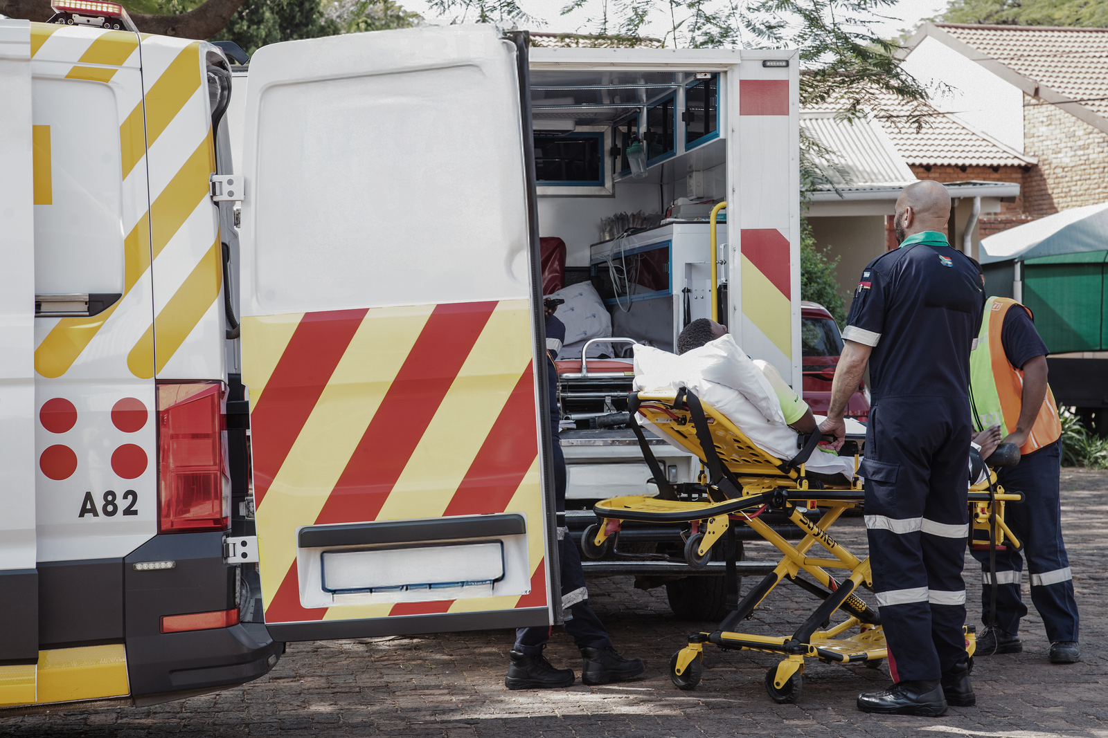

Site visit schedule
Day | Site | Time allocated | Venue
Monday (Rotational with Ivan Plats) | Bokoni Mine | 09h30 - 14h30 | Main Office
Tuesday | Bokoni Mine Middlepunt | 09h30 - 14h30 | HR Boardroom
Wednesday | Polokwane Smelters | 09h30 - 15h00 | HR Boardroom
Thursday | Mogalakwena South Concentrator Mogalakwena Mine Mogalakwena North Concentrator | 09h00 – 10h30 10h30 – 12h00 12h00 - 14h30 | HR Boardroom HR Boardroom HR Boardroom & GSS (Rotational)
Friday | Ivan Plats Industrial Site | 09h30 - 11h30 | TBC
Friday | Ivan Plats | 12h00 - 14h40 | HR Boardroom
Client Liaison Call Centre
Tel: 014 590 1700 or 080 000 6942 (toll free)
WhatsApp: 080 000 6942
Facebook
Linkedin
Instagram
Emergency: 0861 746 548
2

